Slide 1
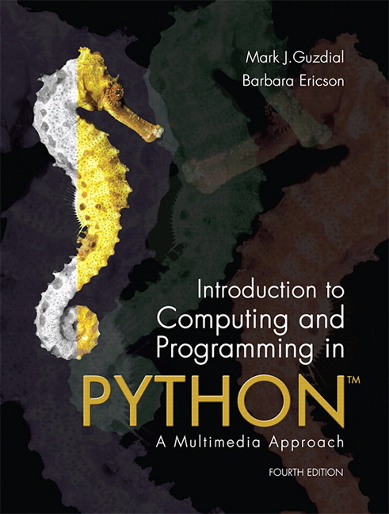
CSE 8A – Introduction to Programming and Computational Problem Solving I
CS1-LLMs Materials © 2023 by Leo Porter, Dan Zingaro, Beth Simon, and Christine Alvarado is licensed under CC BY-NC-SA 4.0
Image Processing Part 2
How to get help:
Class Website
https://sites.google.com/ucsd.edu/cse8afa23/home
Piazza for brief questions or logistic questions
Tutor Hours for help with homework/setting up computer To get help, use Autograder (directions on piazza)
Office Hours for homework/conceptual help
Slides based, in part, on materials from Dan Zingaro, Beth Simon, and Christine Alvarado.
Notes:
Welcome!

Slide 2
Processor performance
From 1990-2004, the performance of a processor running a single thread (single process that only uses one core) improved by 52% annually. What amount does it increase by annually today? Pick closest.
100%
75%
50%
25%
12%
Hennessy, J. L., & Patterson, D. A. (2019). A new golden age for computer architecture. Communications of the ACM, 62(2), 48-60.
Notes:
It’s actually 3% right now.

Slide 3
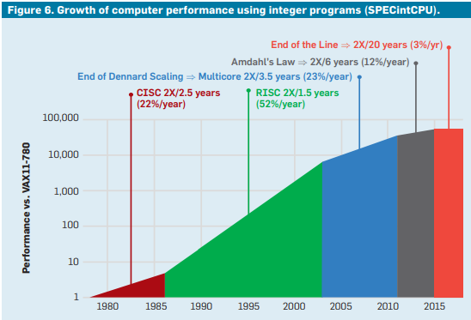
Hennessy, J. L., & Patterson, D. A. (2019). A new golden age for computer architecture. Communications of the ACM, 62(2), 48-60.
Notes:
Growth is 3% annually right now. Unlikely to grow significantly again without a major breakthrough.
Story isn’t over here – there’s still a lot of interesting work going on with security and writing parallel software and for code that’s easy to parallelize like graphics and machine learning. But things aren’t good for single threaded workloads right now. ☹

Slide 4
Announcements
Homework 7 due Monday at 10pm
Quiz 3 in lab Wednesday
Take Home Lab 7
Emphasizes tuples, strings, lists, nested loops, basic image processing, and dictionaries
Project 2 – Images
Releasing later today/tomorrow
Lecture on next Tuesday (11/21) is remote
No Lab next week

Slide 5
Learning Goals for Today
By the end of today’s lecture, you should be able to:
Read and modify Python code that manipulates images using the Pillow (PIL) library

Slide 6
Tracing Nested Loops
def printTraversal(image):
width, height = image.size
for x in range(width):
for y in range(height):
print(x, y)
What will the code above print if the width is 2 and height is 3?
A. 0 0
0 1
0 2
1 0
1 1
1 2
B. 0 0
1 0
2 0
0 1
1 1
2 1
C. 0 0
0 1
1 0
1 1
2 0
2 1
D. 0 0
1 1
2 2
Notes:
A

Slide 7
Nested Loops: In what order are pixels changed?
def makeColor(image, color):
width, height = image.size
for x in range(width):
for y in range(height):
image.putpixel((x,y), color)
x
y
Notes:
C – inner is top to bottom, outer is left to right. Talk through what the diagrams mean because they aren’t super clear.

Slide 8
Nested Loops: In what order are pixels changed?
def makeColor(image, color):
width, height = image.size
for y in range(height-1,-1,-1):
for x in range(width):
image.putpixel((x,y), color)
x
y
Notes:
B – inner is left to right, outer is bottom to top. Talk through what the diagrams mean because they aren’t super clear.

Slide 9
How to make an image of vertical stripes
def makeVerticalStripes(image, color1, color2):
result = image.copy()
width, height = image.size
for x in range(width):
for y in range(height):
if(________________):
result.putpixel((x,y), color1)
else:
result.putpixel((x,y), color2)
return result
What line should go in the missing blank to create a striped pattern:
x > width/2
x < width/2
x % 2 == 0
y % 2 == 1
None of the above
Notes:
C – then we should show them how to make thicker stripes when we run the code (e.g., x % 16 < 8)
A or B would make some really big stripes!
D would be horizontal, not vertical stripes.

Slide 10
Copying the left half onto the right half
sourceX | sourceY | targetX | targetY
Notes:
Let’s think through how to do this. Let’s start with a drawing. Then let’s figure out which pixels we want copied onto other pixels.
sourceX = width/2 and then just let it keep increasing makes sense. Could ask about odd number of pixels.

Slide 11
Fill in the code below to copy the left half of the image to the right. You may assume the width is even (but feel free to also handle odd).
def copyLeftToRight(image):
width, height = image.size
rightX = __________________________
for x in range(_____________________)):
for y in range(________________):
color = ______________________________
image.putpixel(__________________, color)
rightX = _________________________
Notes:
def copyLeftToRight(image):
width, height = image.size
rightX = width - int(width/2)
for x in range(int(width/2)):
for y in range(height):
color = image.getpixel((x,y))
image.putpixel((rightX,y), color)
rightX = rightX + 1

Slide 12
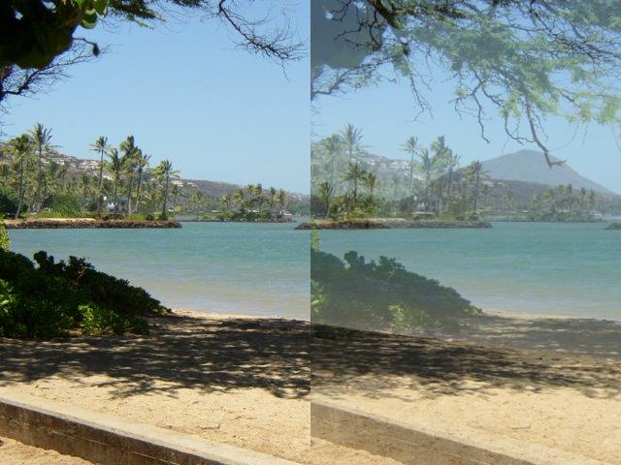
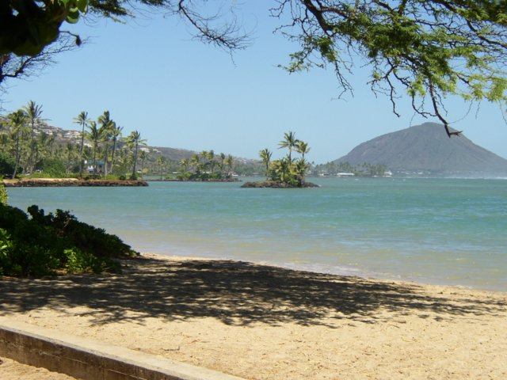
Work with your group to change the previous code to blend the left onto the right. For example:
Notes:
Let’s think through how to do this. How might you blend the color of two pixels? Try something easy to get you started and see how that goes. Maybe see if they can say find the average to blend them?

Slide 13
Skeleton code for blendLeftToRight
def blendLeftToRight(image):
width, height = image.size
leftX = ______________________
for x in range(_____________):
for y in range(__________):
leftX = leftX + 1
Notes:
Print so they can fill this in
def blendLeftToRight(image):
width, height = image.size
leftX = width - int(width/2)
for x in range(int(width/2)):
for y in range(height):
rL, gL, bL = image.getpixel((x,y))
rR, gR, bR = image.getpixel((leftX,y))
color = (int((rL+rR)/2),int((gL+gR)/2),int((bL+bR)/2) )
image.putpixel((leftX,y), color)
leftX = leftX + 1

Slide 14
Summary
The Pillow (PIL) library offers useful functions for working with images
We can manipulate images in a variety of ways
Today we did basic operations like copying parts of one image onto other parts of the same image. We’ll continue to grow the complexity in the next few classes
Notes:
Next lecture. Copy one image onto another. Red-eye reduction. Edge Detection.

